Slide 1


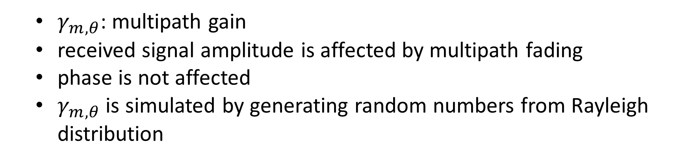
Recap: Unknown Flat Fading
$γ_{m,θ}$: multipath gain
received signal amplitude is affected by multipath fading
phase is not affected
$γ_{m,θ}$ is simulated by generating random numbers from Rayleigh distribution

Slide 2
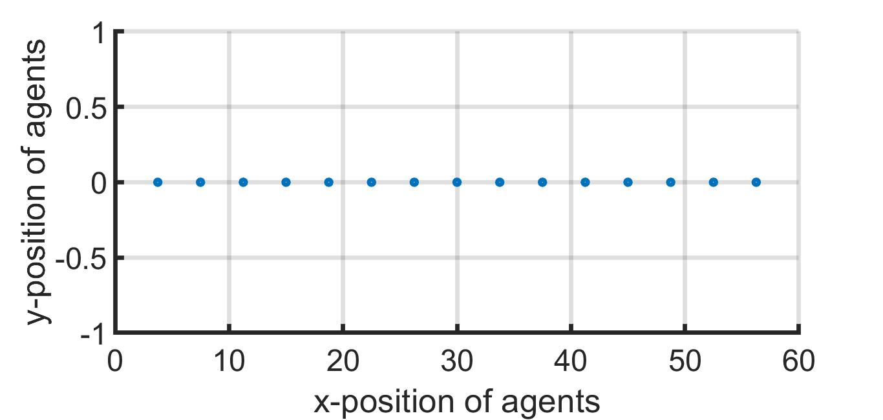
1-D Array

Slide 3
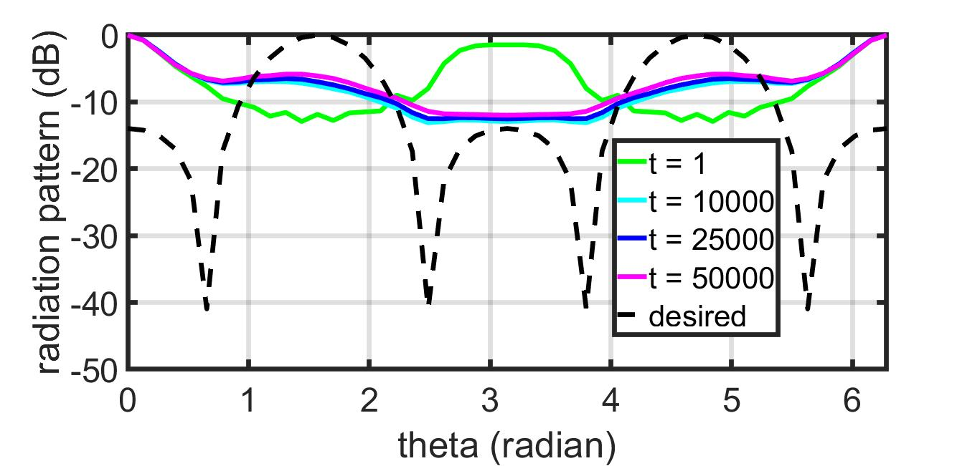
GD – 1-D Array – Known Fading
Uniform weightage of samples

Slide 4
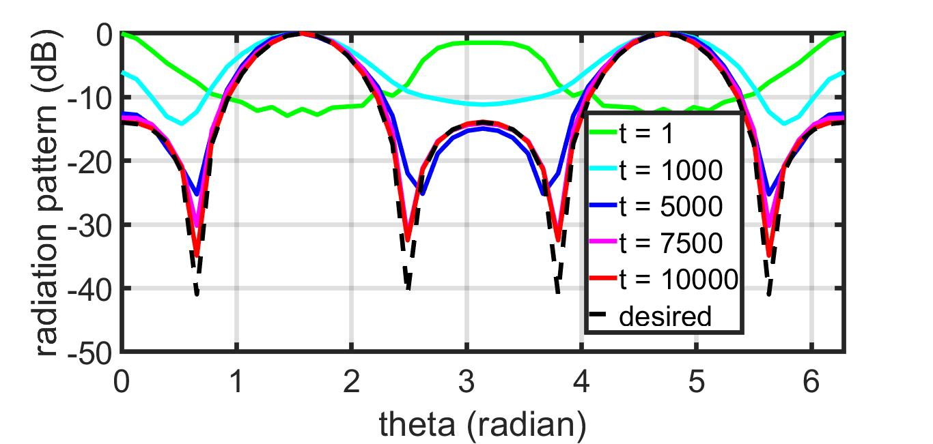
IPG – 1-D Array – Known Fading
Uniform weightage of samples

Slide 5
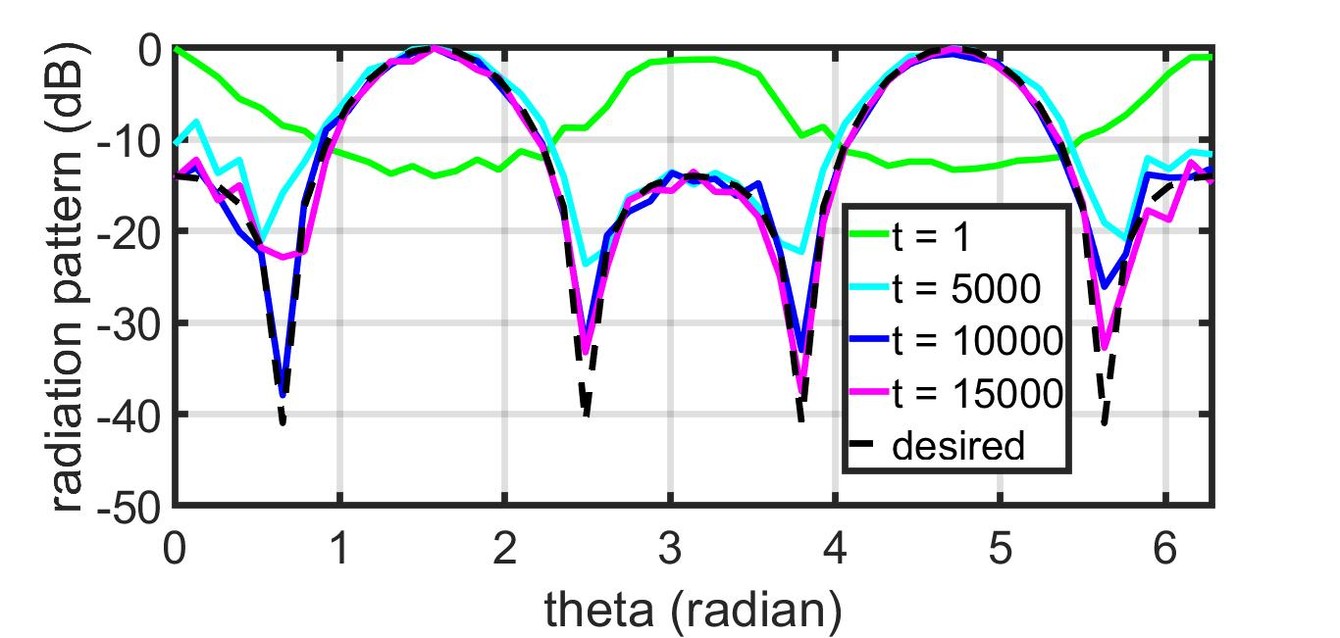
IPG – 1-D Array – Unknown Fading
Uniform weightage of samples

Slide 6
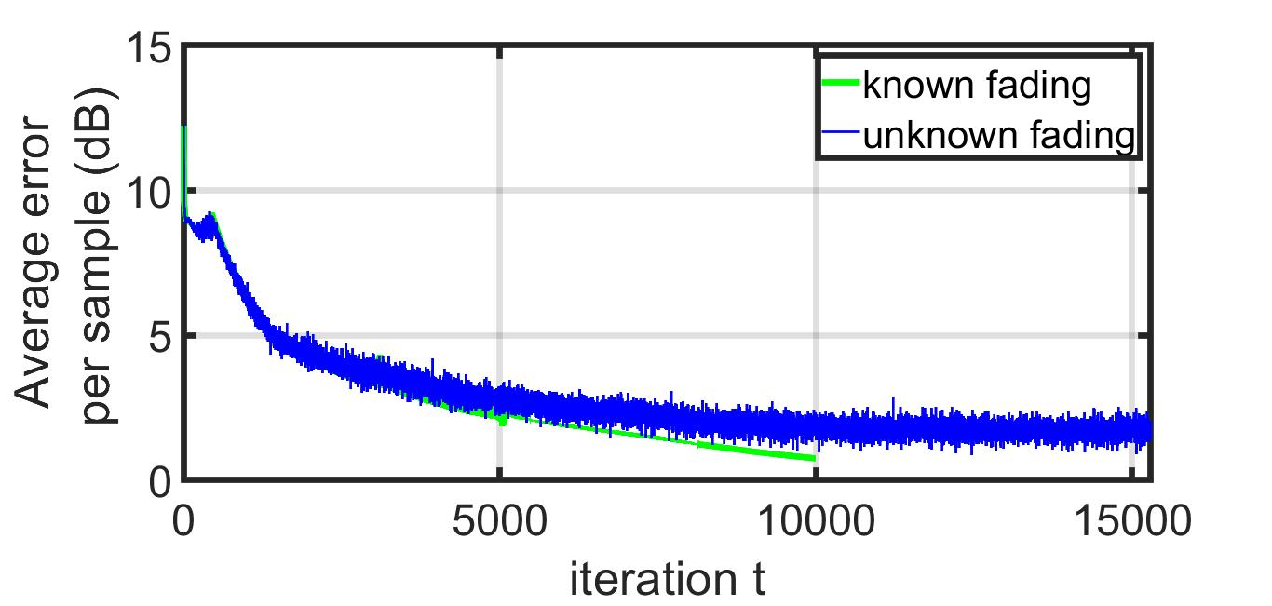
Error ~ Iteration: IPG - 1-D Array

Slide 7
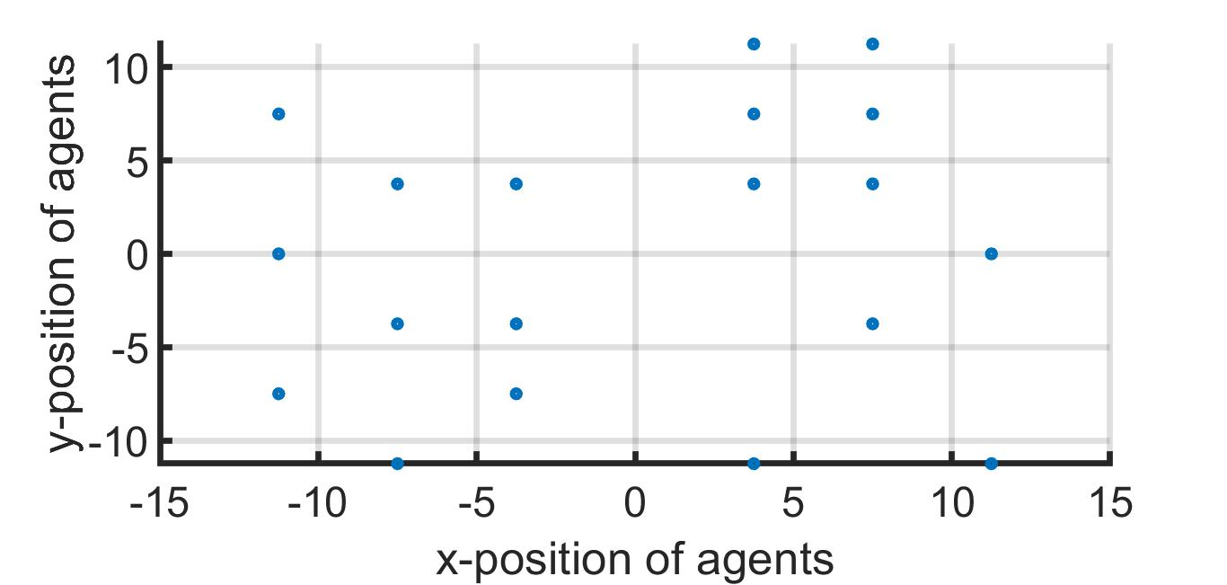
2-D Array

Slide 8
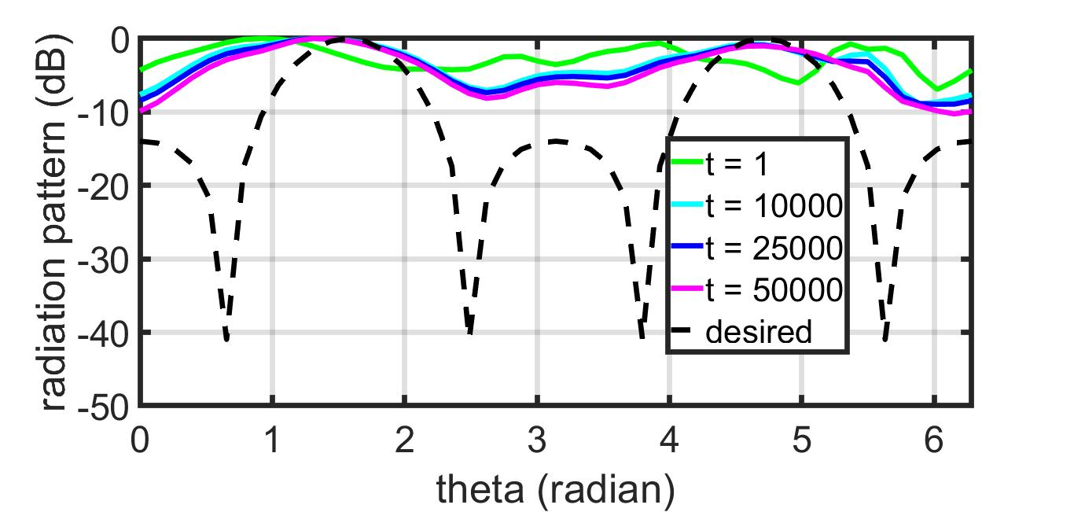
GD – 2-D Array – Known Fading
Uniform weightage of samples

Slide 9
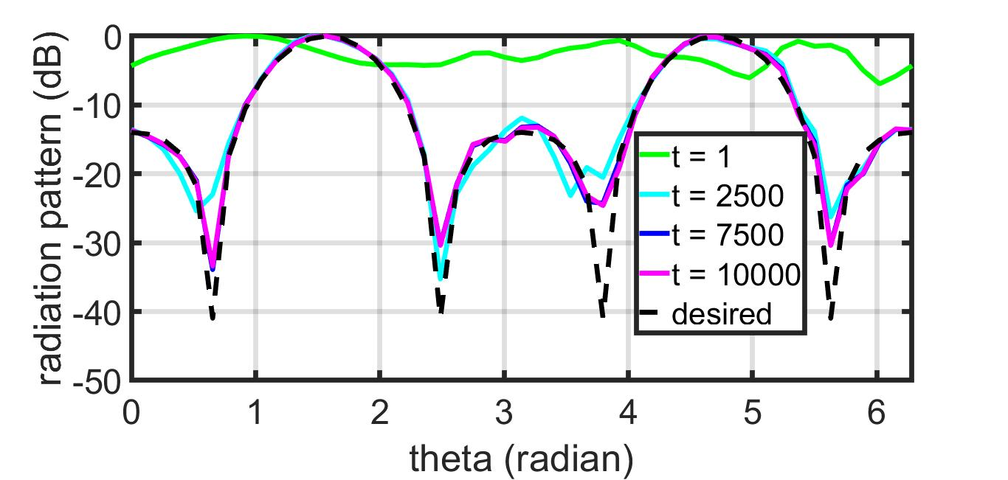
IPG – 2-D Array – Known Fading
Uniform weightage of samples

Slide 10
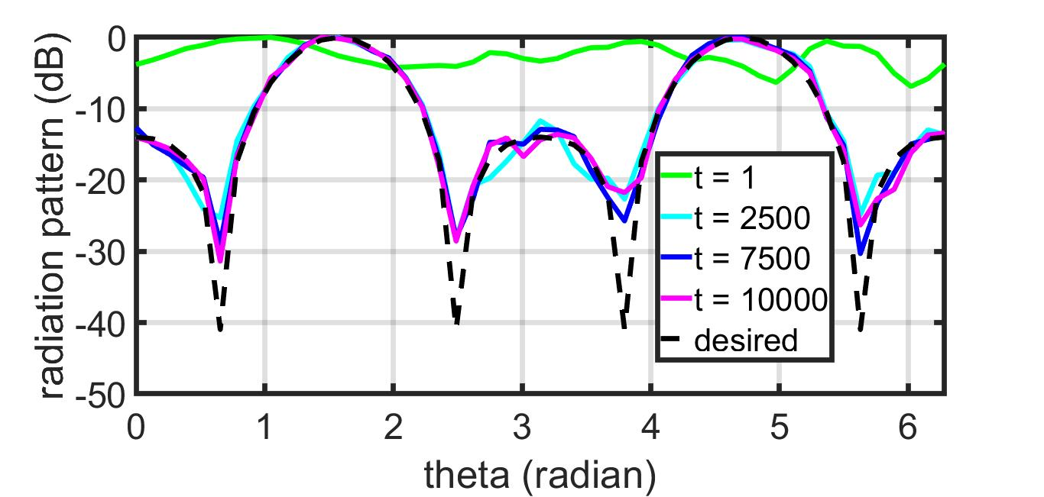
IPG – 2-D Array – Unknown Fading
Uniform weightage of samples

Slide 11
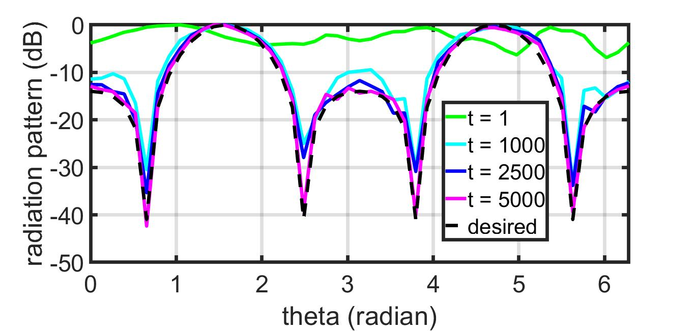

IPG – 2-D Array – Unknown Fading
Weightage of $i^{th}$ sample $1/{\left|f_{i}\right|}$

Slide 12
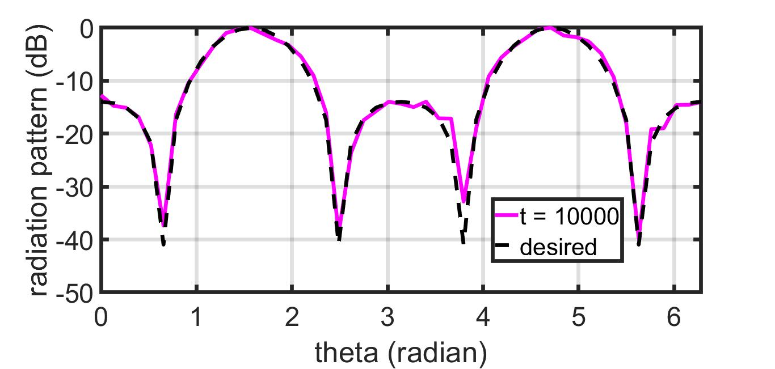
IPG – 2-D Array – More Fading
Weightage of $i^{th}$ sample $1/{\left|f_{i}\right|}$

Slide 13
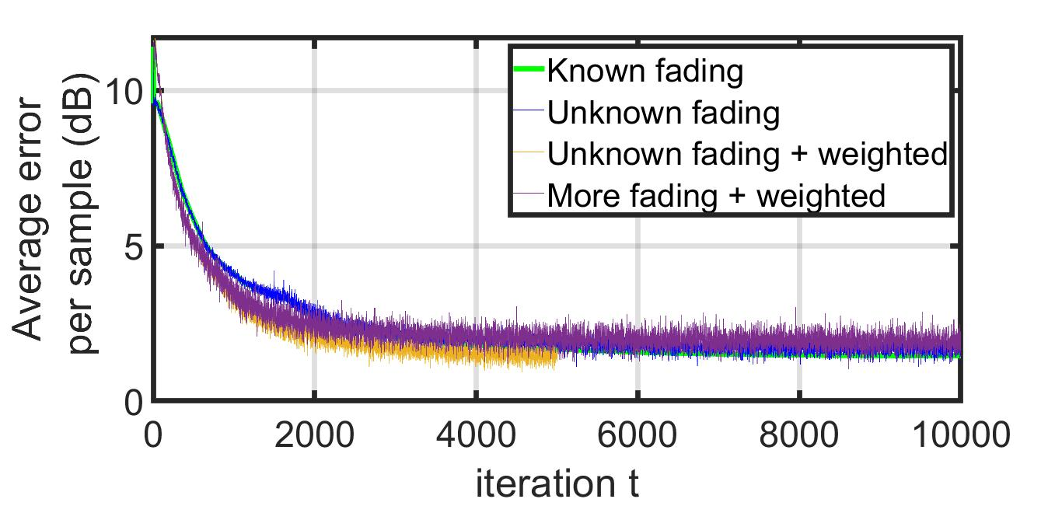
Error ~ Iteration: IPG - 2-D Array

